Slide 1
Investigation of the Bruner Patient Population
By: Zach Adair
MSDS 692: Data Science Practicum I
Regis University

Slide 2
Introduction
The first Practicum for the Data Science program I have decided to work with my employer SCL Health and use data science principles to help get a better understanding of the patient population of one specific clinic.
The clinic we will be looking at is Bruner Family Medicine Center in Denver, CO.
We will be looking at patients with the following Chronic Conditions:
Cancer, Hypertension, Chronic Obstructive Pulmonary Disease (COPD), Coronary Heart Disease (CHD), Obesity, Asthma, Arthritis, Hepatitis, Diabetes and Weak or Failing Kidneys

Slide 3

Objective For this study
The reason for looking at these Chronic Conditions is these 10 have been recorded in the United States for being roughly 5% of the patient population but account for almost 50% of patient and hospital costs.
The objective of this investigation is to gain a deeper understanding of patients with these chronic conditions and find what key variables from their patient encounter or from their social environments might indicate a trend to help care for these patients and possibly help prevent them from contracting one of these conditions.

Slide 4

Project Process
Data Collection
Collecting the Data from various locations and pulling it together through a workflow in Alteryx
Exploratory Data Analysis
Understand the dimensions and structure in RStudio and make sure the dataset is ready for modeling
Visualize different aspects of the dataset using Tableau and then turning those insights into interactive dashboards that the end user can use.
Cluster Analysis
Jump Back into RStudio to run a Hierarchical Cluster Analysis (HCA) and K-Means clustering methods upon the dataset and draw conclusions about the patient population
Reflection
What was learned about the patients
What could have made the project better
Next Steps

Slide 5
Data Collection – Patient Encounter Build
Starting in Epic, I had to bring in patients from the Epic Database by the Patient Encounter level of granularity. Not only did I need patient encounter information though, I had to join this data to bring in demographic info about the patient, facility details, and diagnosis code information.

Slide 6
Data Collection – Reference Tables
Since I was bringing in data about patients social environments I needed to research different websites for social determinants.
I found a great deal of my social determinants from websites like cdc.gov and adt.com.
I also needed a way to link this information to my patients
Using zip codes and counties I was able to find a solution which allowed insight about where these patients were coming from.

Slide 7
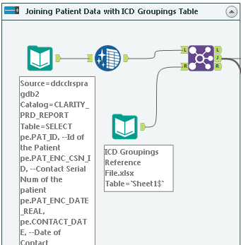
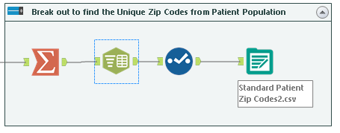
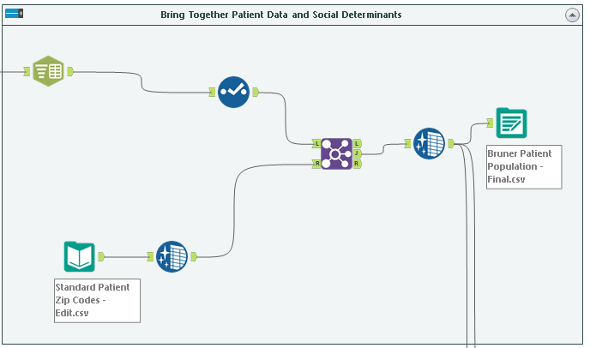
Data Collection – Bringing It all together
The best tool at my disposal to bring my patient data, and my reference files together is a tool we use at SCL Health called Alteryx which is great for joining, cleansing, and manipulating data so to better use it for analysis and modeling.

Slide 8
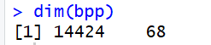
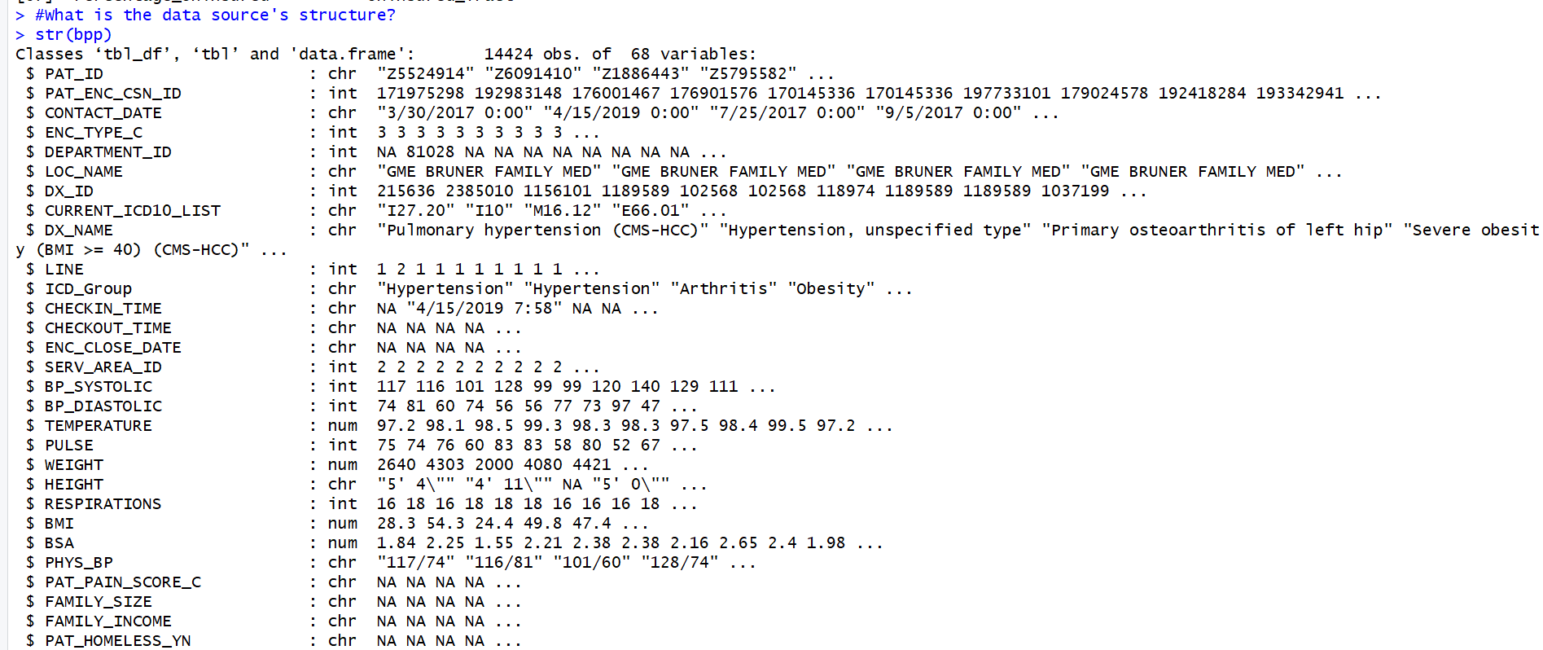
Exploratory Data Analysis
The first steps in any go EDA process is learning about the dimensions and structure of your overall dataset.
This will help give you knowledge about the dataset so when you go to model you will know what kind of information you could possibly get back.
Dimensions
Structure

Slide 9
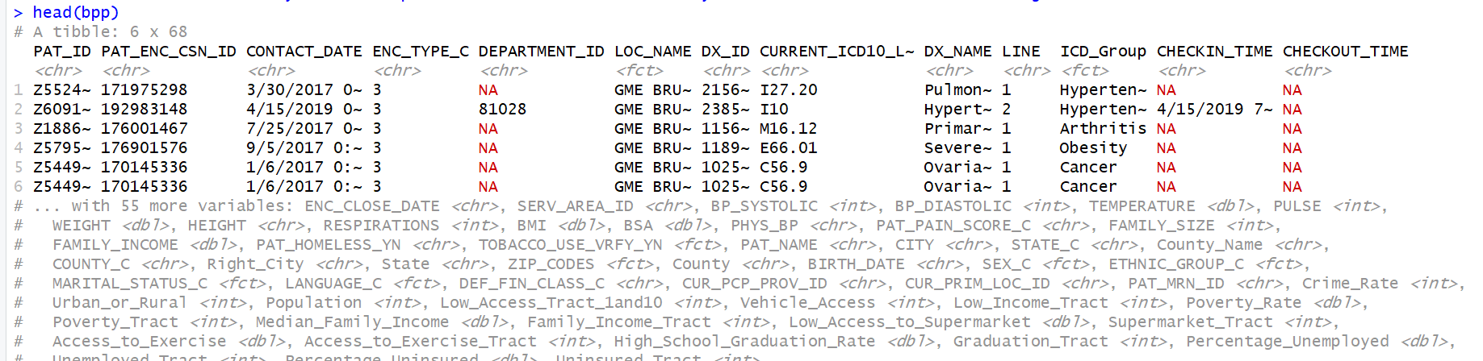
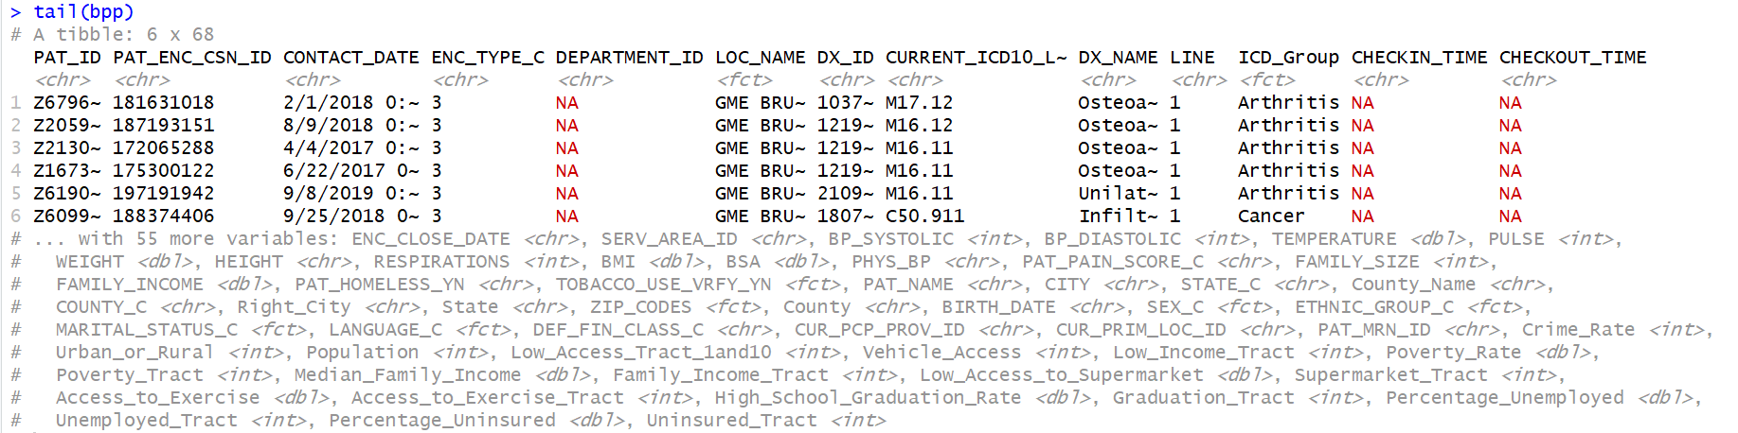
Exploratory Data Analysis
When running the structure command I found I had to change some of the data types of my data.
It was 23 out of my 68 variables that needed changed.
2 to numeric, 8 to factor, 13 to character based.
From there, I was able to move on and check how well my data fed into RStudio.

Slide 10
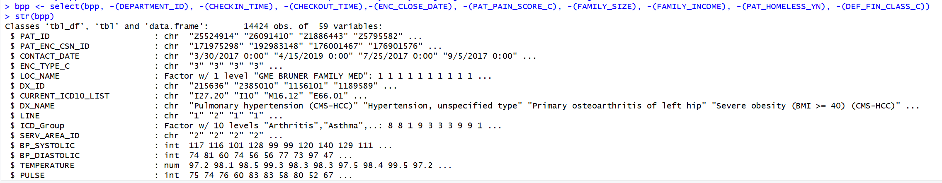
Exploratory Data Analysis
With there being nulls or NA’s within the dataset that needs to be fixed before moving forward.
This was done by establishing which fields had null values, and then determining if those fields had validity to the project going forward.
They did not so all 9 fields with null values were dropped from the dataset.

Slide 11
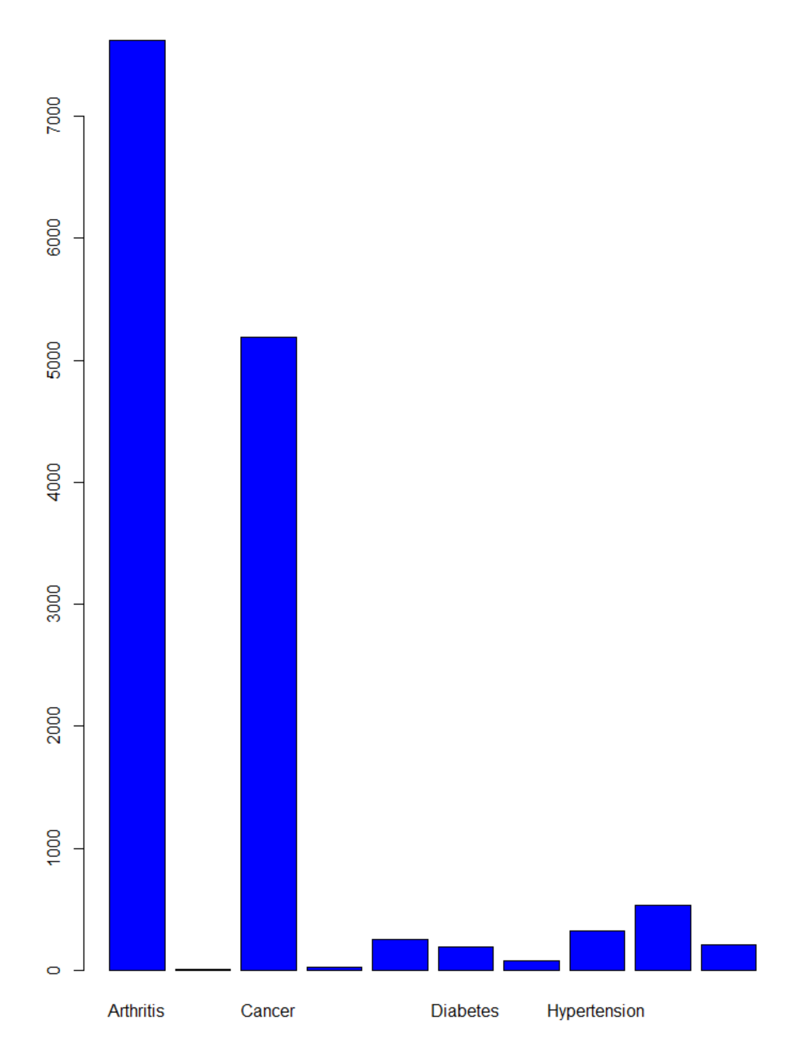
Exploratory Data Analysis
Now that our data is cleaned up and were no longer concerned about null values we can move to checking out the distribution of some of the variables. One in particular is the Chronic Conditions:
As seen to the left, a great majority of patients have either arthritis or cancer with very little patients having any of the other 8 chronic conditions.

Slide 12
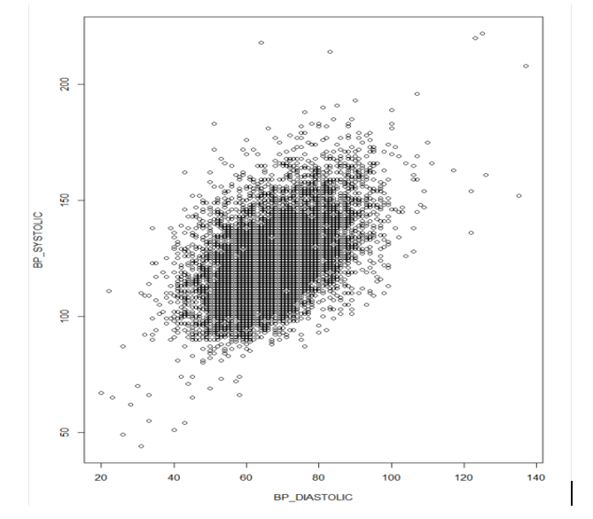
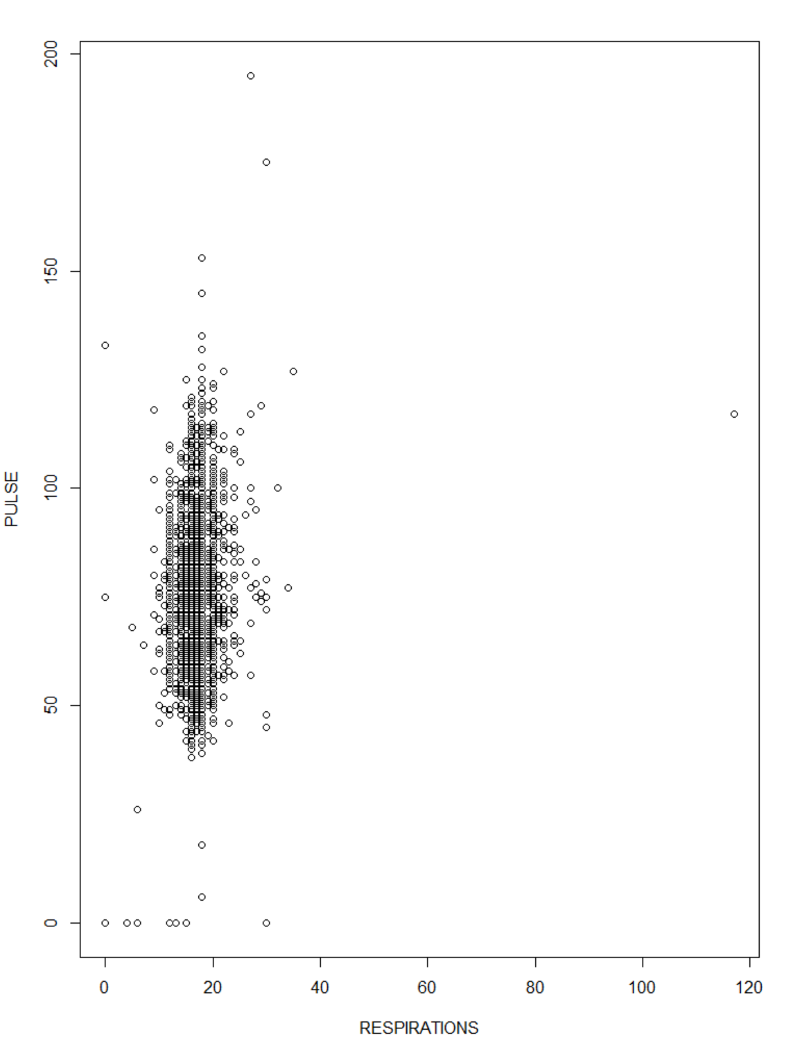
Exploratory Data Analysis
Next, we can look into the relationship of some of the variable pairs and look at any kind of correlation we might possibly have with them.
Below there are two pairs of patient vitals compared to each other, it looks like there could be some relationship between the blood pressures but between pulse and respirations that is harder to see.
BP Systolic vs. BP Diastolic
Pulse vs. Respirations

Slide 13
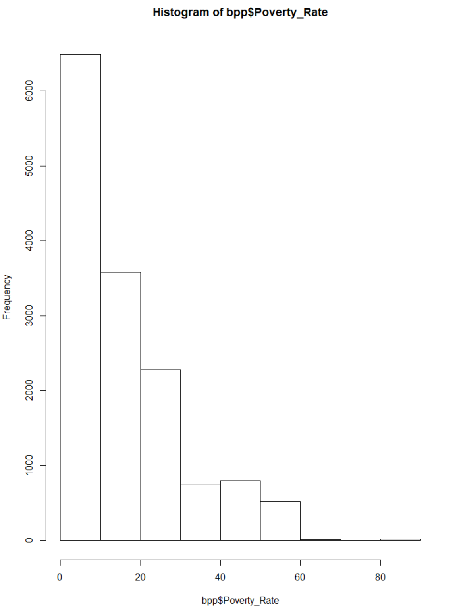
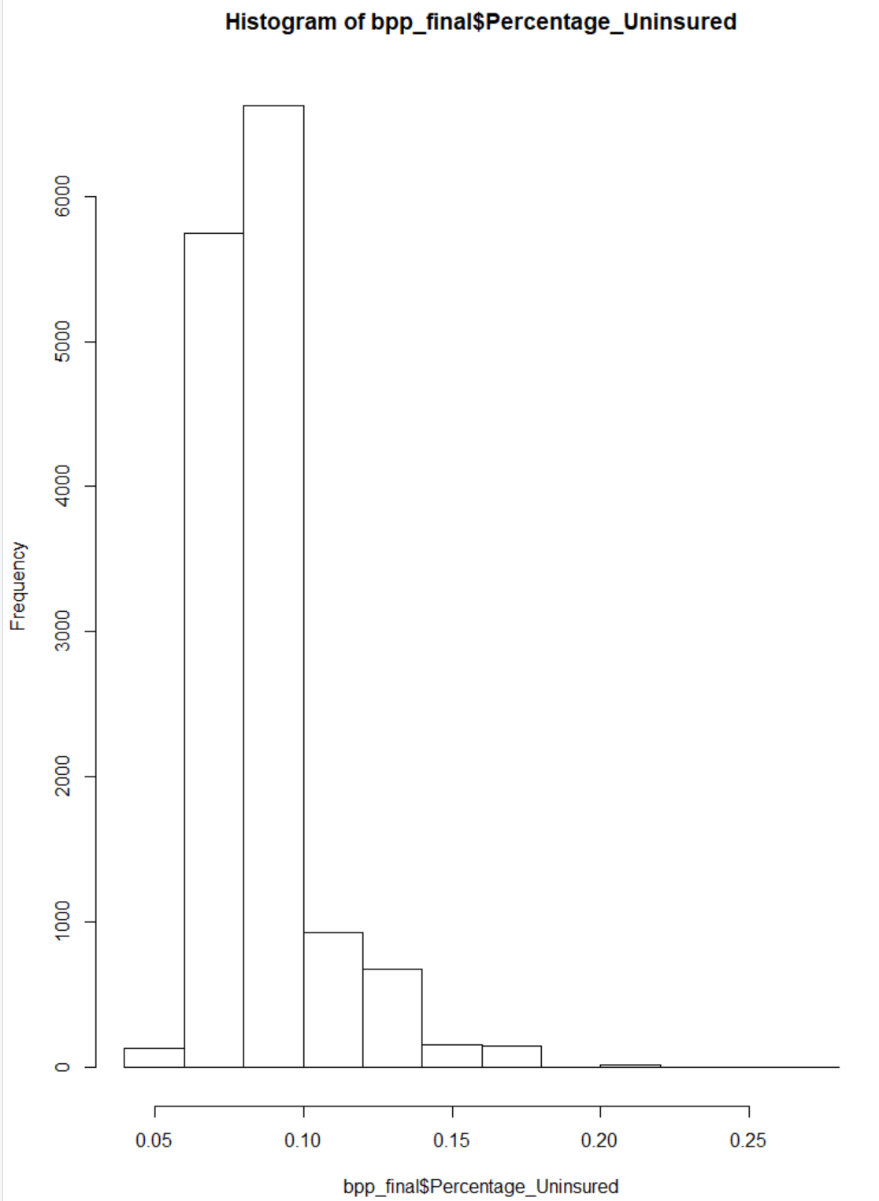
Exploratory Data Analysis
Another great view of our data is to understand the distribution of variables.
Using histograms we are able to see what the distribution of our vitals might be.
Both Poverty Rate and Percentage Uninsured appear to skewed towards the lighter side of the possible metric but a fair amount appear to live in high poverty and high uninsured areas.
Poverty Rate
Percentage Uninsured

Slide 14
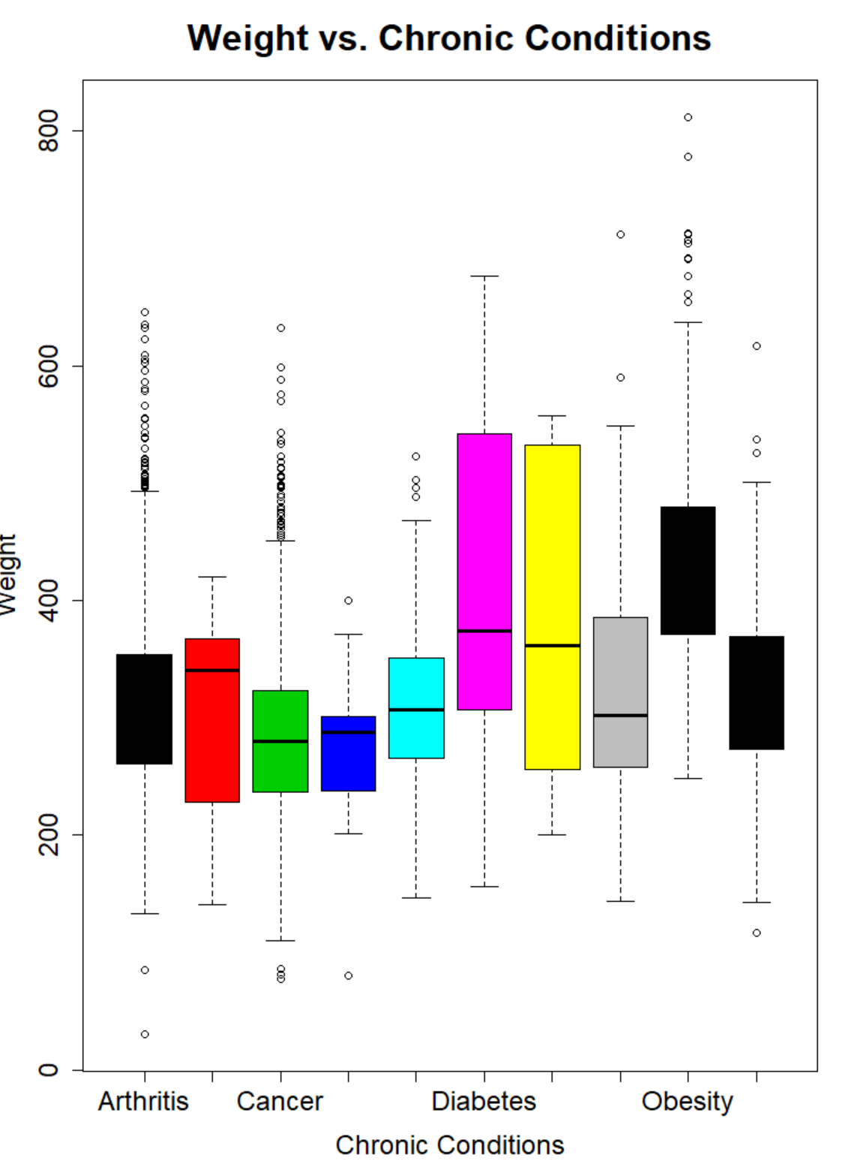
Exploratory Data Analysis
Histograms are a great way to compare the distribution of one measure across each level of a dimension.
Like we see with the variation in weight per patients’ chronic conditions, it appears that patients' weights fluctuate a lot between different chronic conditions.

Slide 15
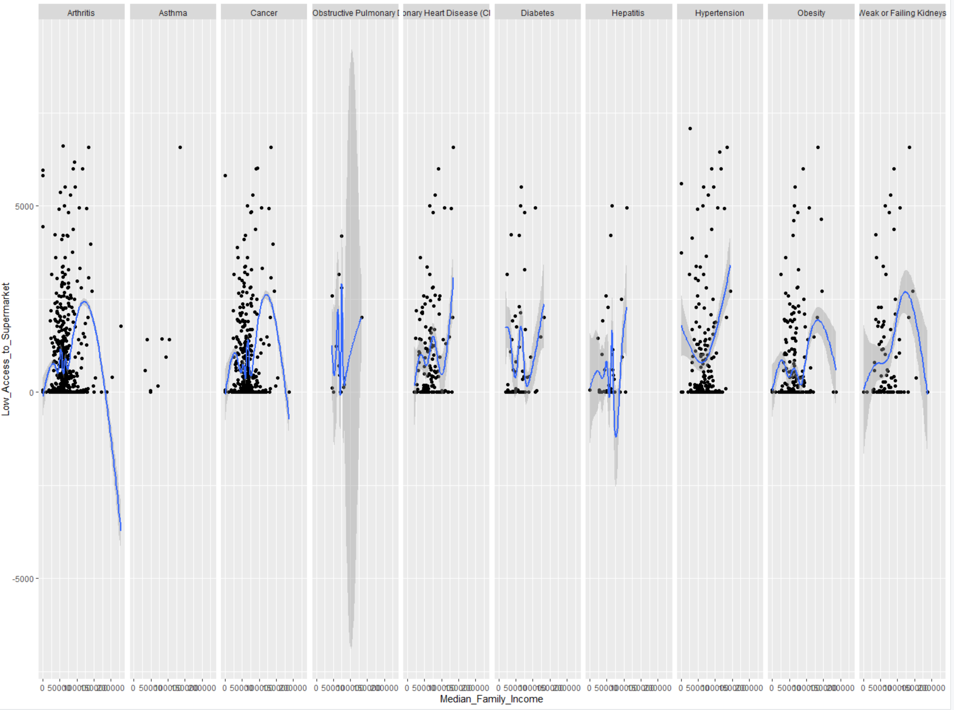
Exploratory Data Analysis
The final plot used during this EDA was qplots, which like histograms can divide data by its levels and show the differences in measures when plotted separately, the difference between a qplot and histogram is now we can bring in multiple measures and compare possible correlation as well.
Comparing by supermarket access and median family income we see the disparity between the chronic conditions. What is also seen however is the effect of not having enough data points for a specific level like what we see with asthma.

Slide 16
Exploratory Data Analysis – What we learned
The structure of the dataset overall is big in number of variables, but a good amount for the number of records.
Cleaned and prepared the dataset moving forward.
Looked at the distribution of patients per chronic conditions
Took a sneak peek at the possible correlations of different variables.

Slide 17
Visualizing the patient population
To help get this data and information out faster within SCL I implemented the use of Tableau Dashboards
With these dashboards I was able to provide dynamic dashboards where we could alter the look of the material to dive deeper and find more about the patient population.

Slide 18
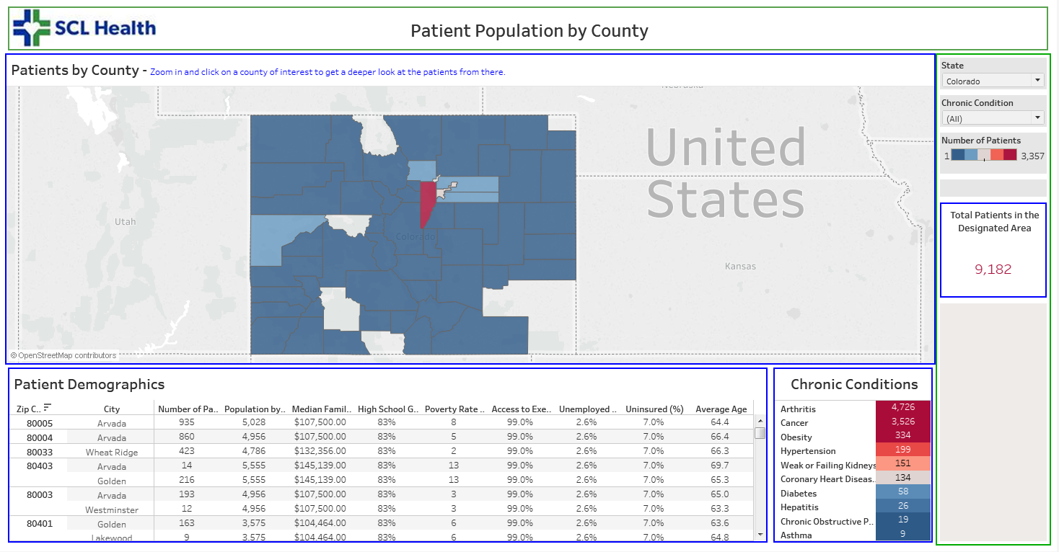
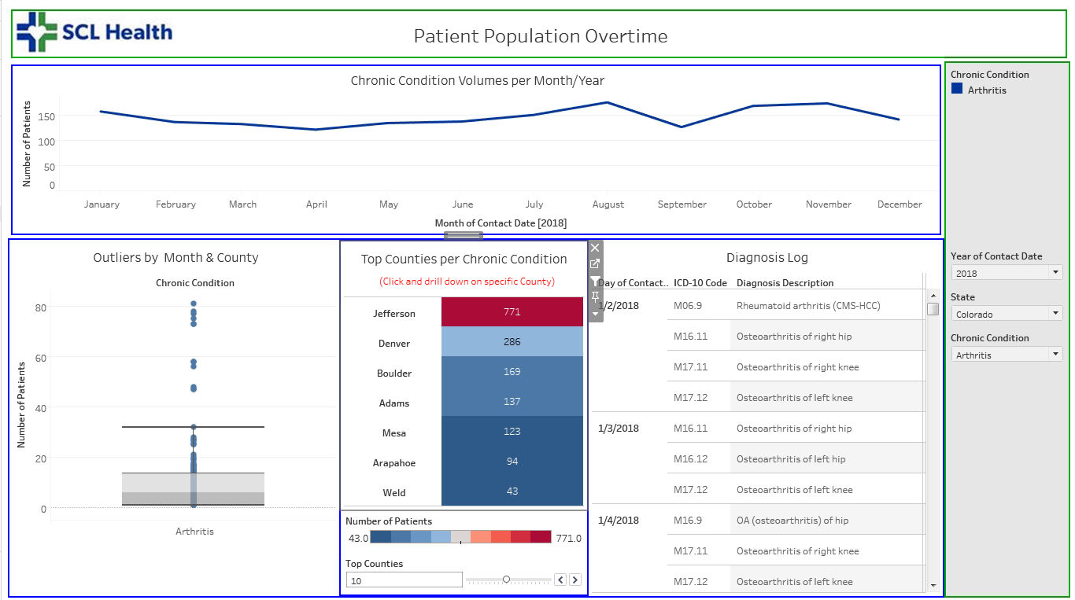
Visualizing the Patient Population
I started by looking at the patients and the areas they came from.
By understanding where most patients come from it could make it easier their social environments as well.
What we know is the patient population primarily resides in the Denver area, from the Jefferson, Denver, Adams, and Arapahoe county areas.
Also learned over the past 3 years there has been a rise in cancer patients in most counties within Colorado.

Slide 19
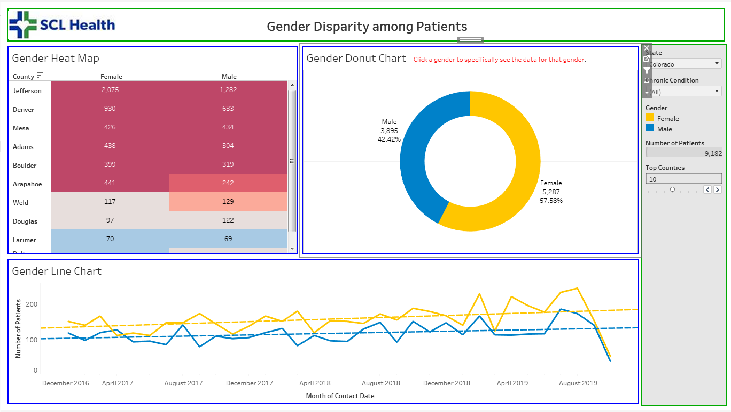
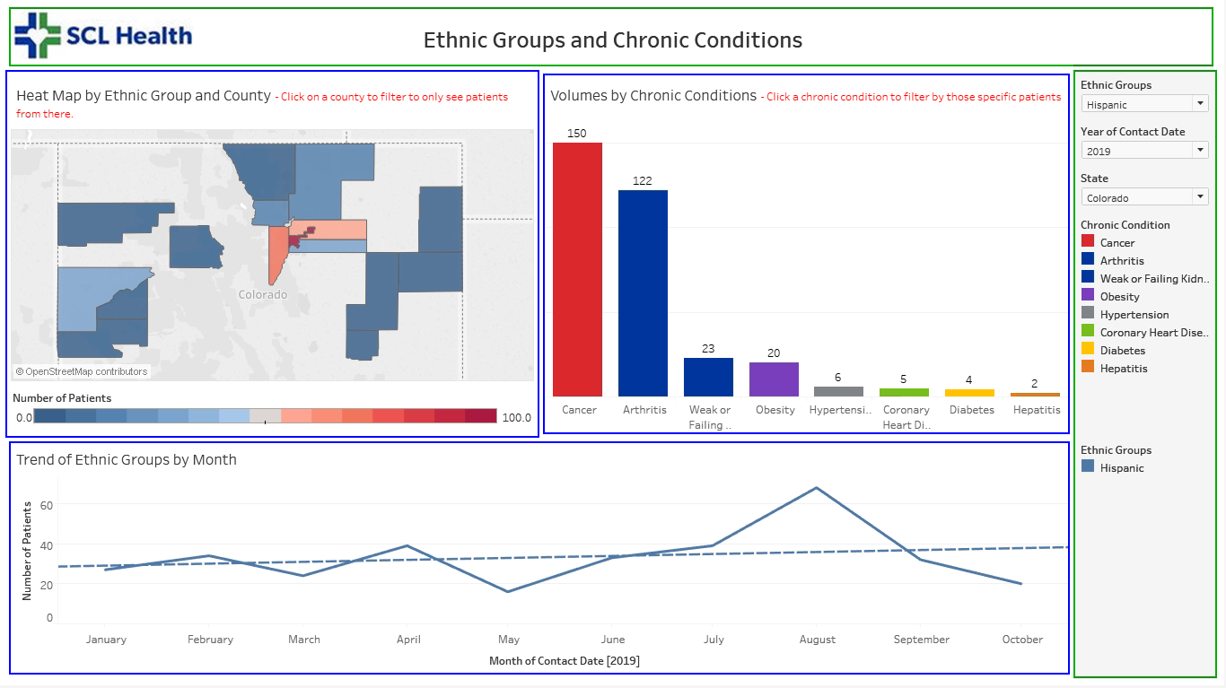
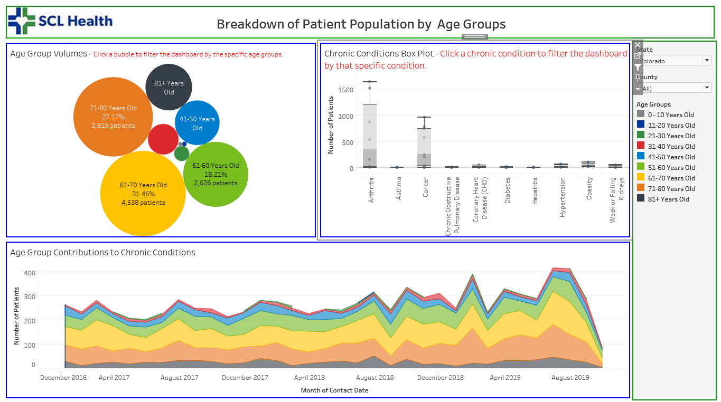
Visualizing the patient Population
Being able to group our data and look at the patient population amongst groups can be very effective when trying to learn more about a patient population.
The three main groups the data was sliced into was by gender, ethnicity, and age groups.
The female population is dominant over the male population not only overall but in a majority of individual chronic conditions.
The Hispanic population has been on the rise each of the last three years.
The 0-10 and 11-20 age groups have a sparse population but patients age 51-60 and 61-70 have been steadily climbing.

Slide 20
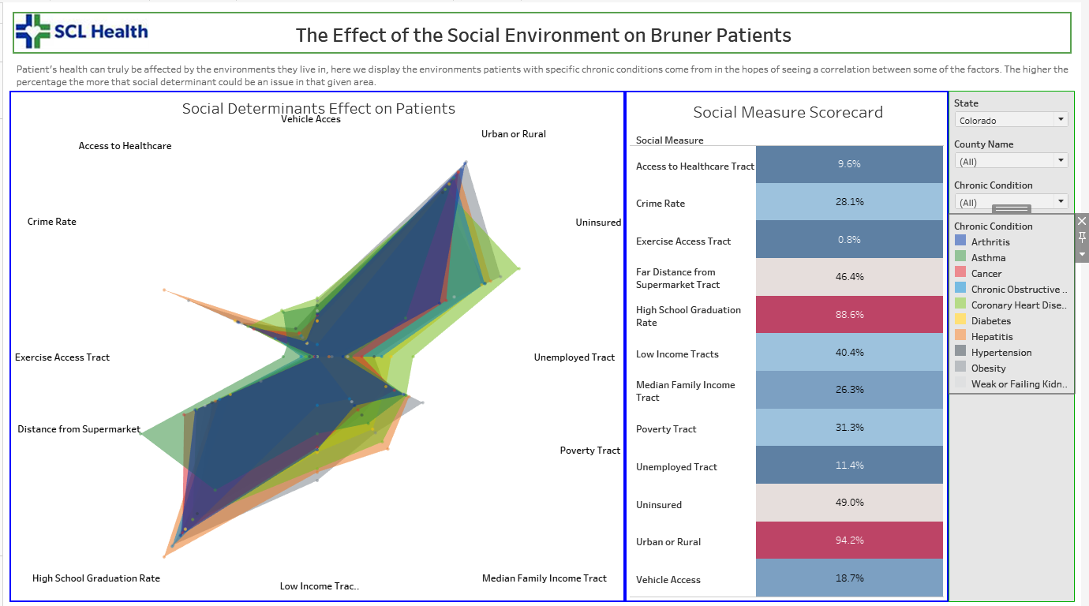
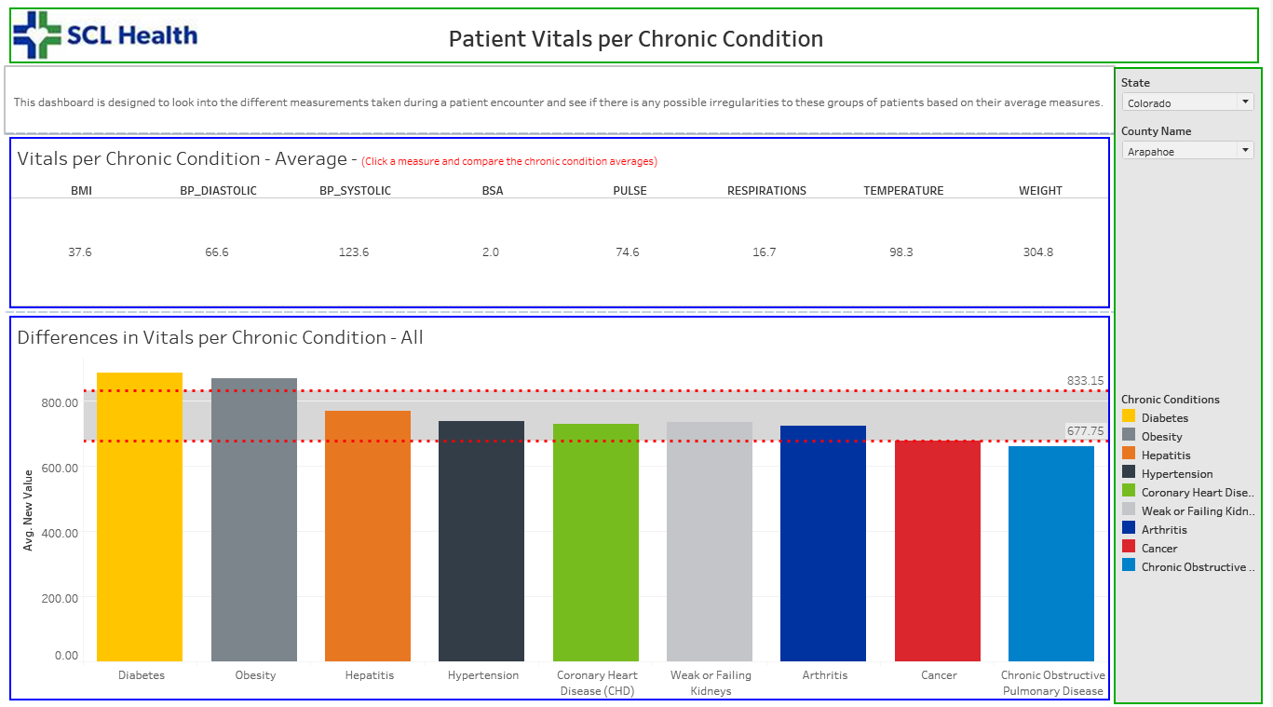
Visualizing the Patient Population
The measures are a very important aspect of the entire study. Learning about how they affect chronic conditions was a vital aspect of it
The goal of these dashboards were to look at which variable had more of an impact on patients as a group, by their chronic conditions.
If one measure was abnormally high it could mean it is something we could key on in the future.

Slide 21
Visualizing the Patient population
The Tableau dashboards have been effective in being able to uncover information about the patients that is below the surface.
Being able to group them differently and discover more about where they come from is something key to this investigation and possibly learning why they have been diagnosed with the chronic conditions they have.

Slide 22
Hierarchical Cluster Analysis
Hierarchical Cluster Analysis (HCA) is a method of cluster analysis which builds a hierarchy of clusters based on the similarities between the variables.
The clustering is presented using a dendrogram, and we will be using the divisive method which will take our dataset as one and then eventually break it out into individual data clusters, our objective is that the data points which are of like chronic conditions will be in the same general clusters before finally breaking out to individual data points.

Slide 23
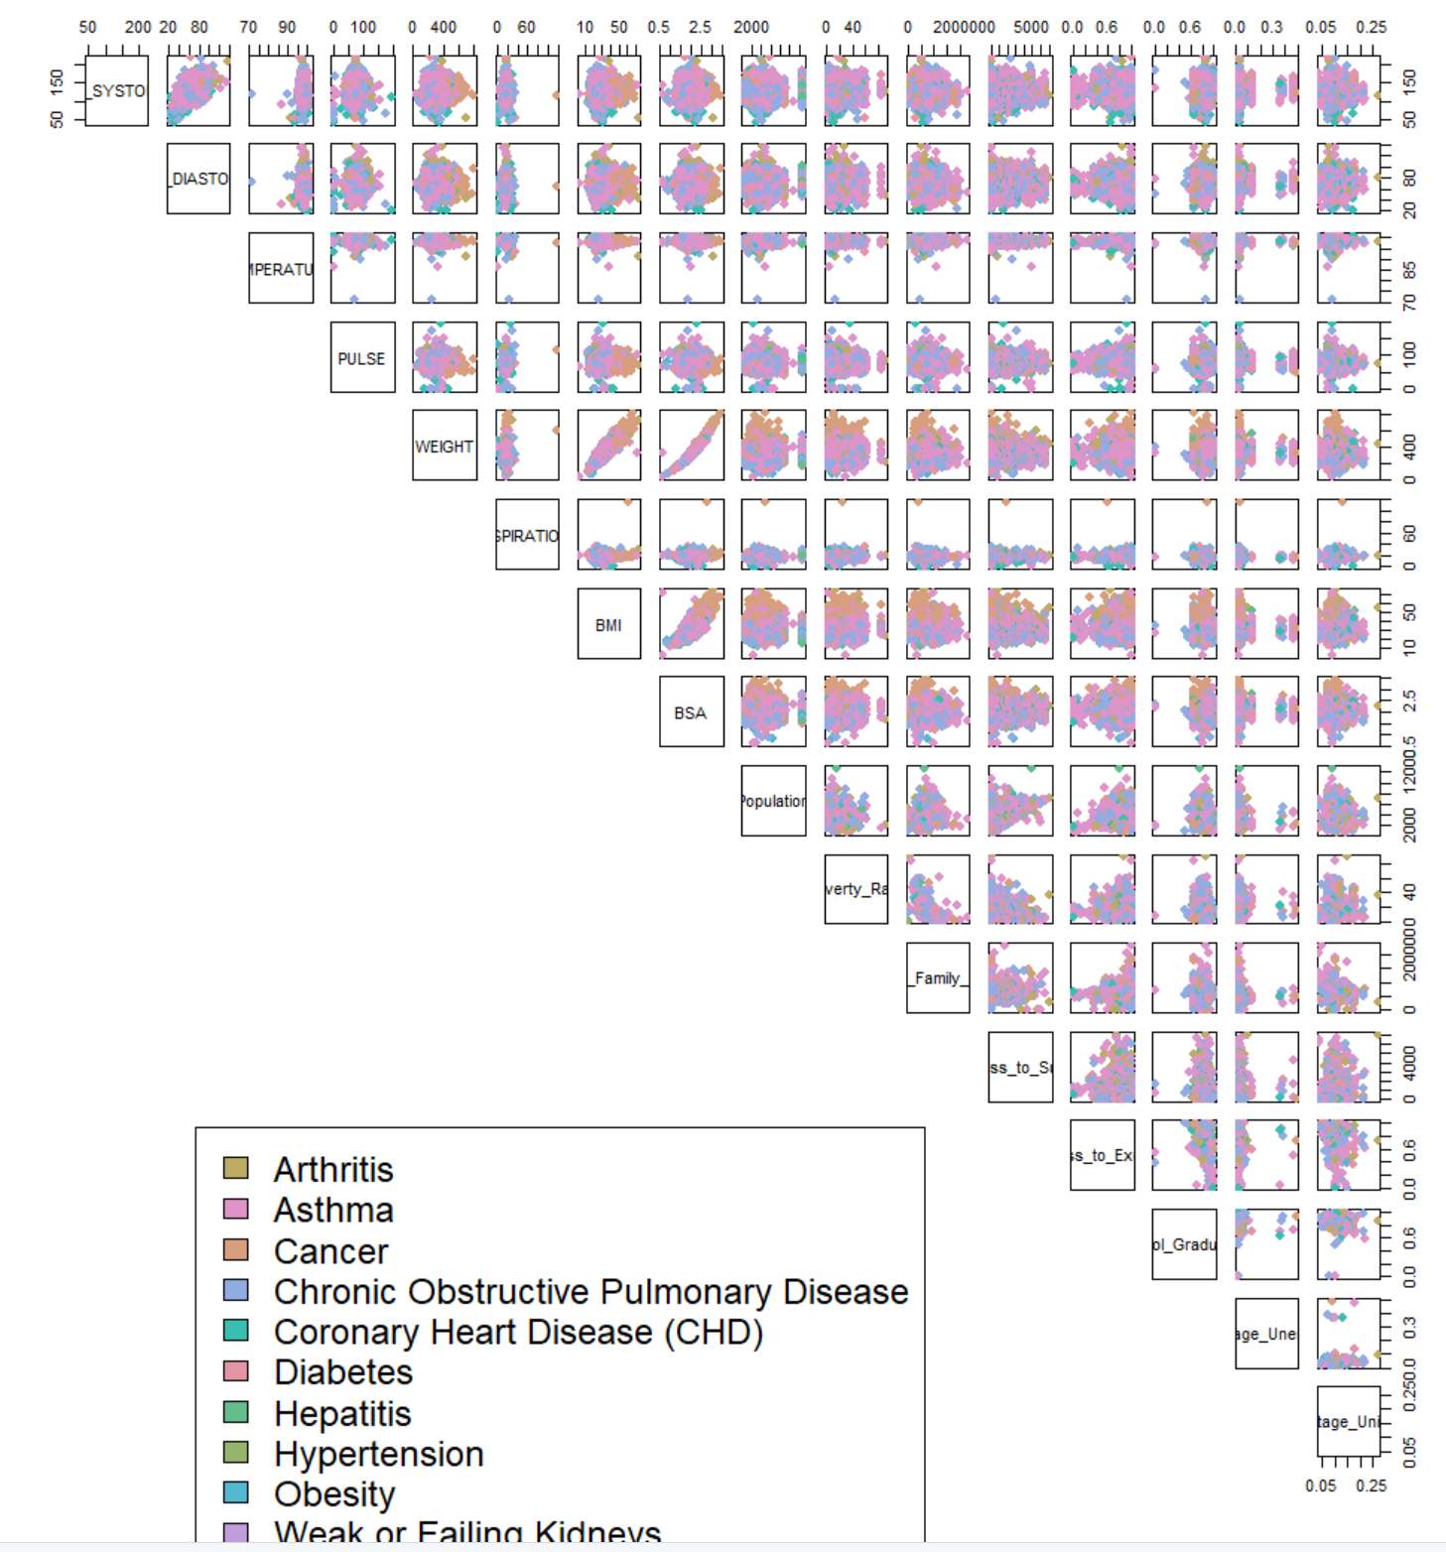
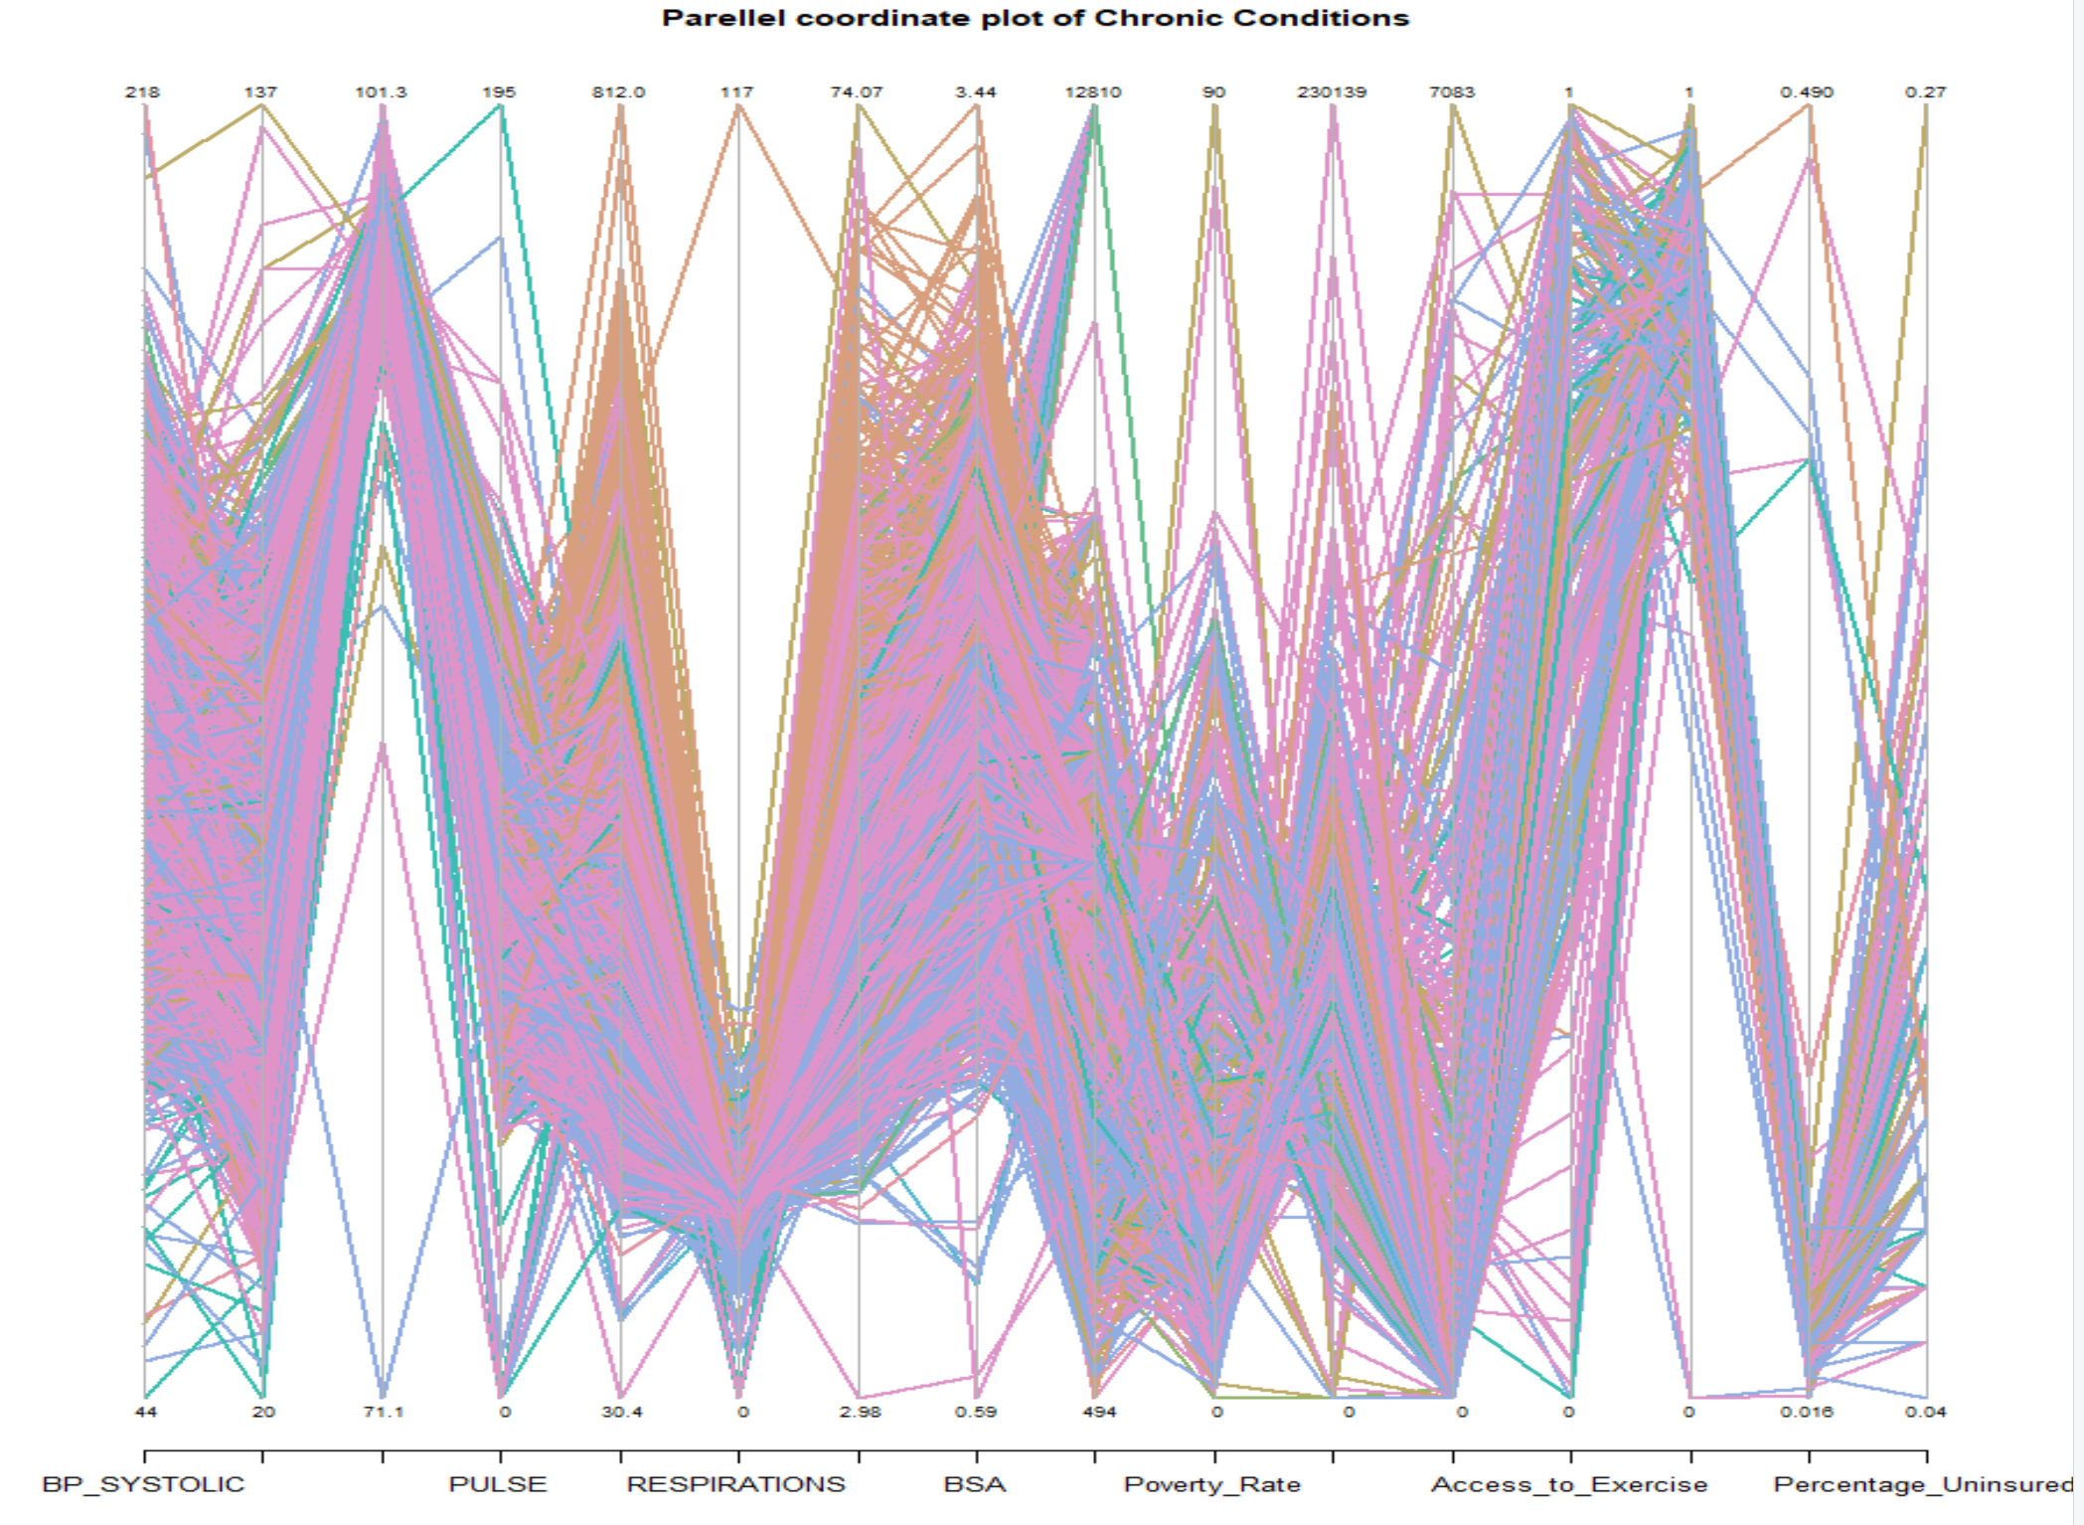
HIERARCHICAL CLUSTER ANALYSIS
Before clustering our data, it is a good idea to look at the metrics one more time and try to measure each pairings likelihood of correlation. This could be done in multiple ways.
The first two are broad looks at the data, breaking out the chronic conditions by color and trying to find how they trend based on measure and pairs.

Slide 24
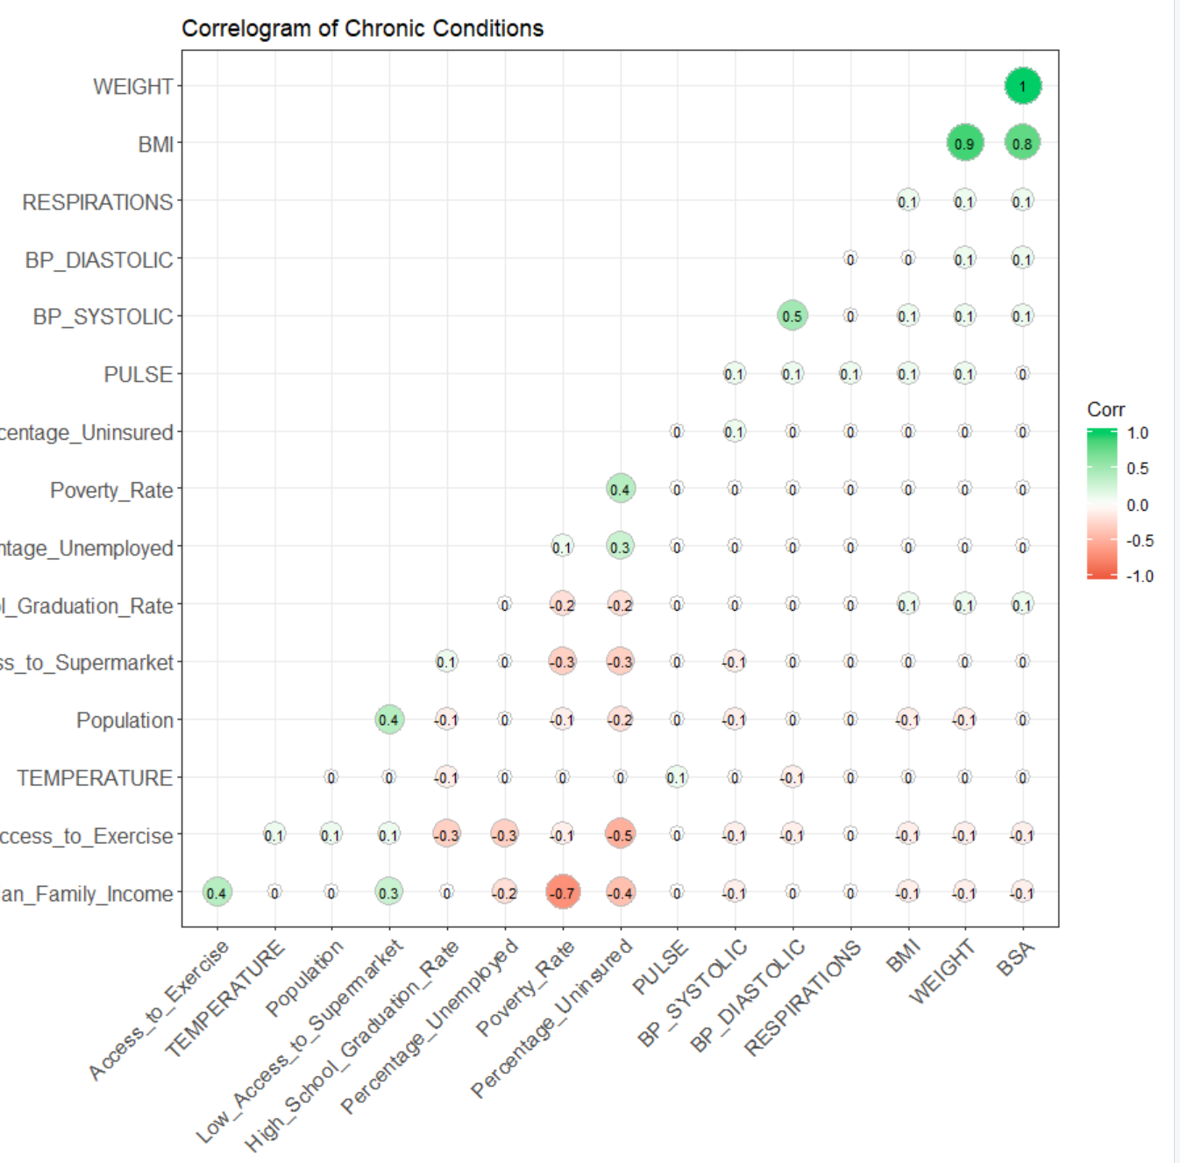
Hierarchical Cluster analysis
A great way to look at correlation between variables is using a correlogram
From the one on the right we several pairs of positively correlated variables as well as a couple of strongly negative correlations.

Slide 25
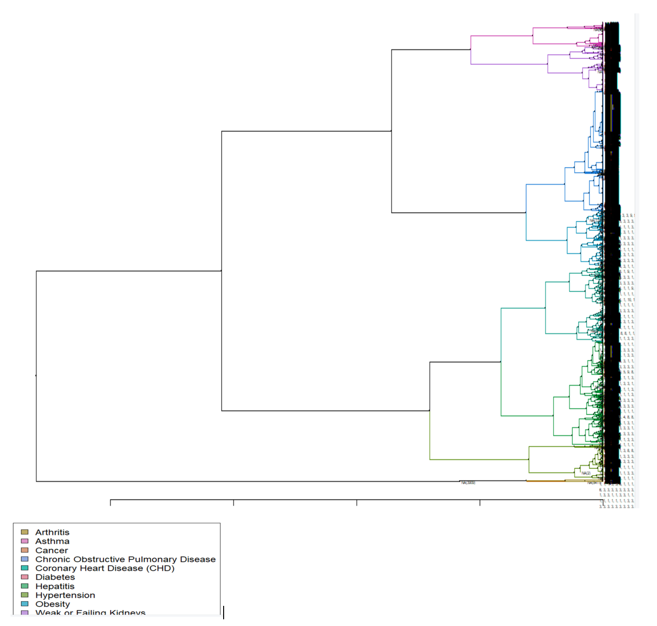
Hierarchical Cluster Analysis
After taking a strong look at our variables were able to move setting up our dendrograms to view each of these clusters.
Coloring our clusters by chronic condition, it initially appears our chronic conditions are broken out really well within this visualization.

Slide 26
Hierarchical Cluster ANalysis
I would like to look deeper into my dendrogram and assess my variables as they lie throughout.
Running a heat map comparison of the measures to the dendrogram we could see a little more how each cluster is being formed.
To not down any of the measures effect on the analysis, I grouped them in groups where the clusters measures are similar in range.

Slide 27
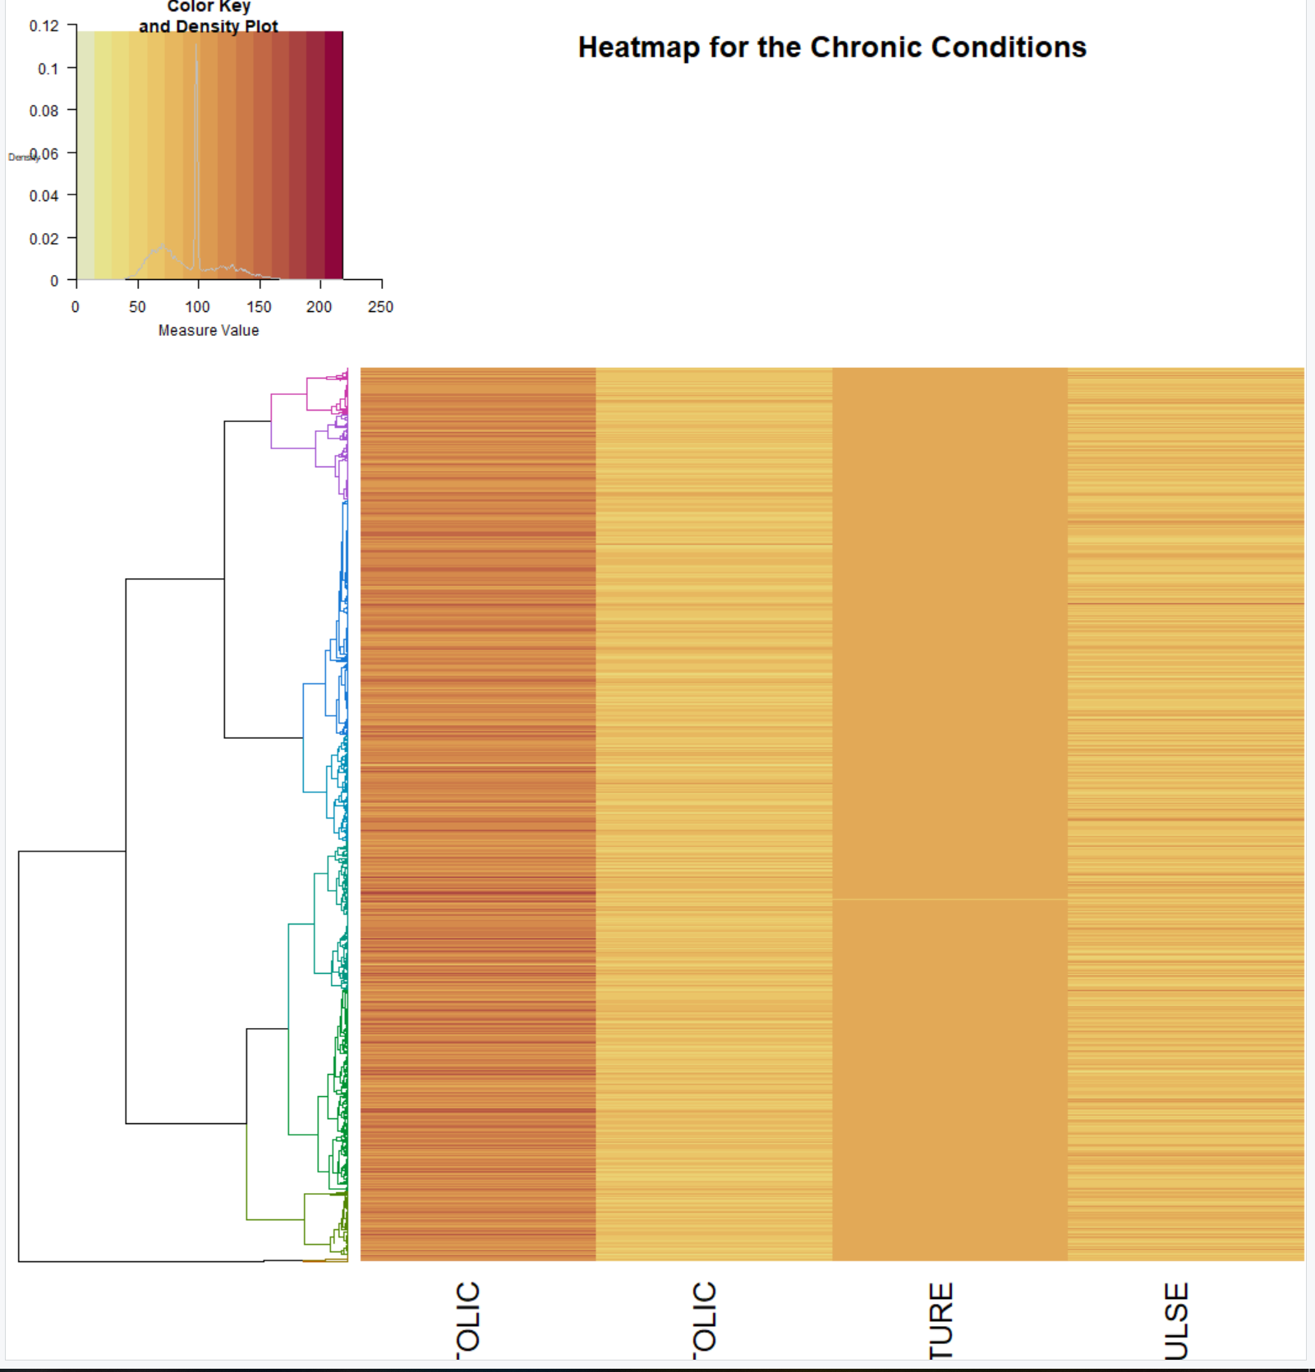
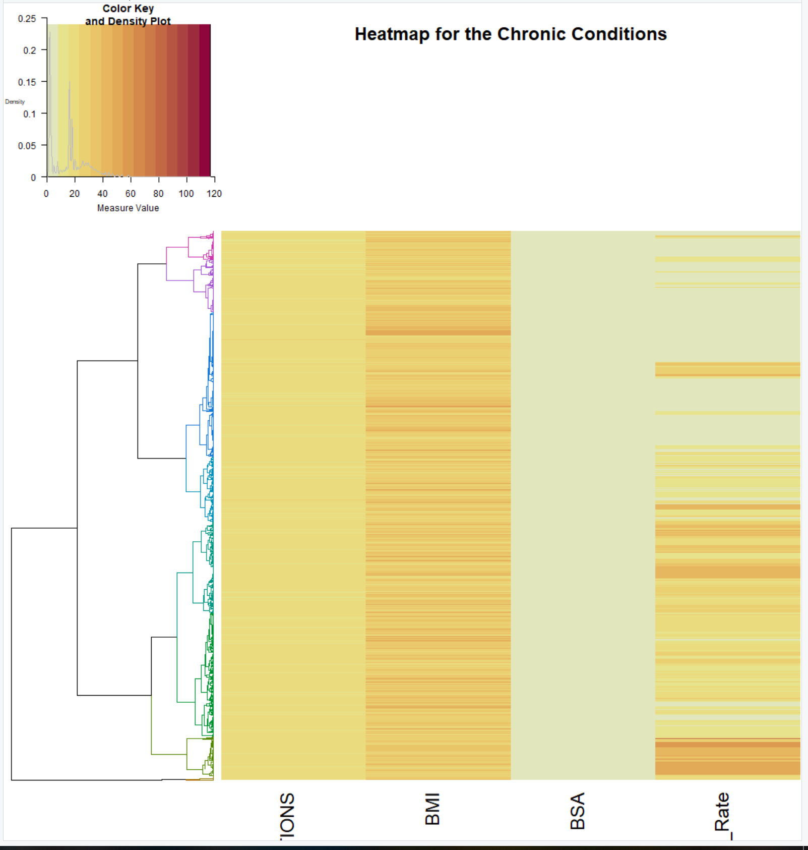
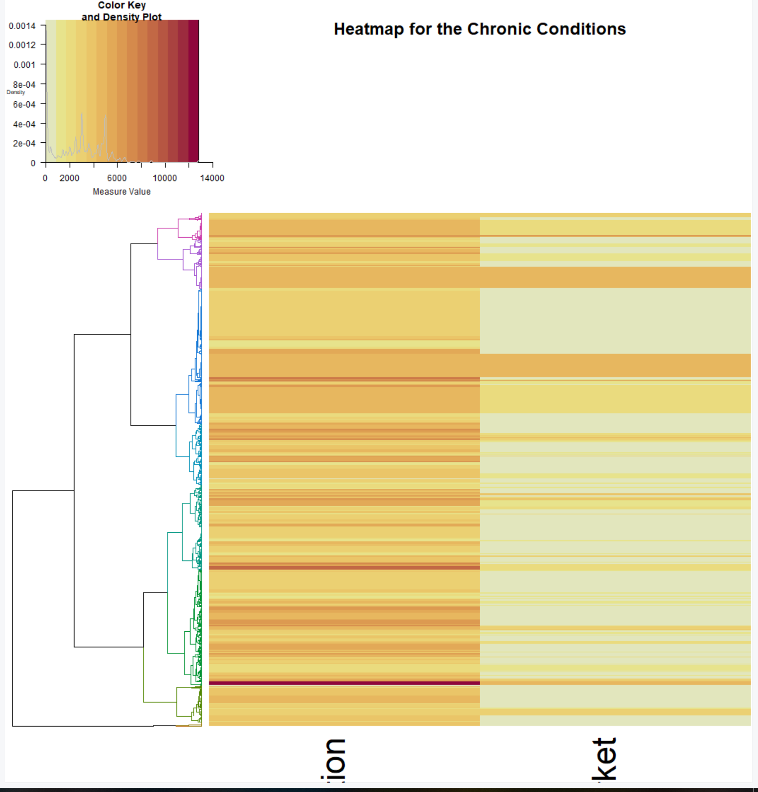
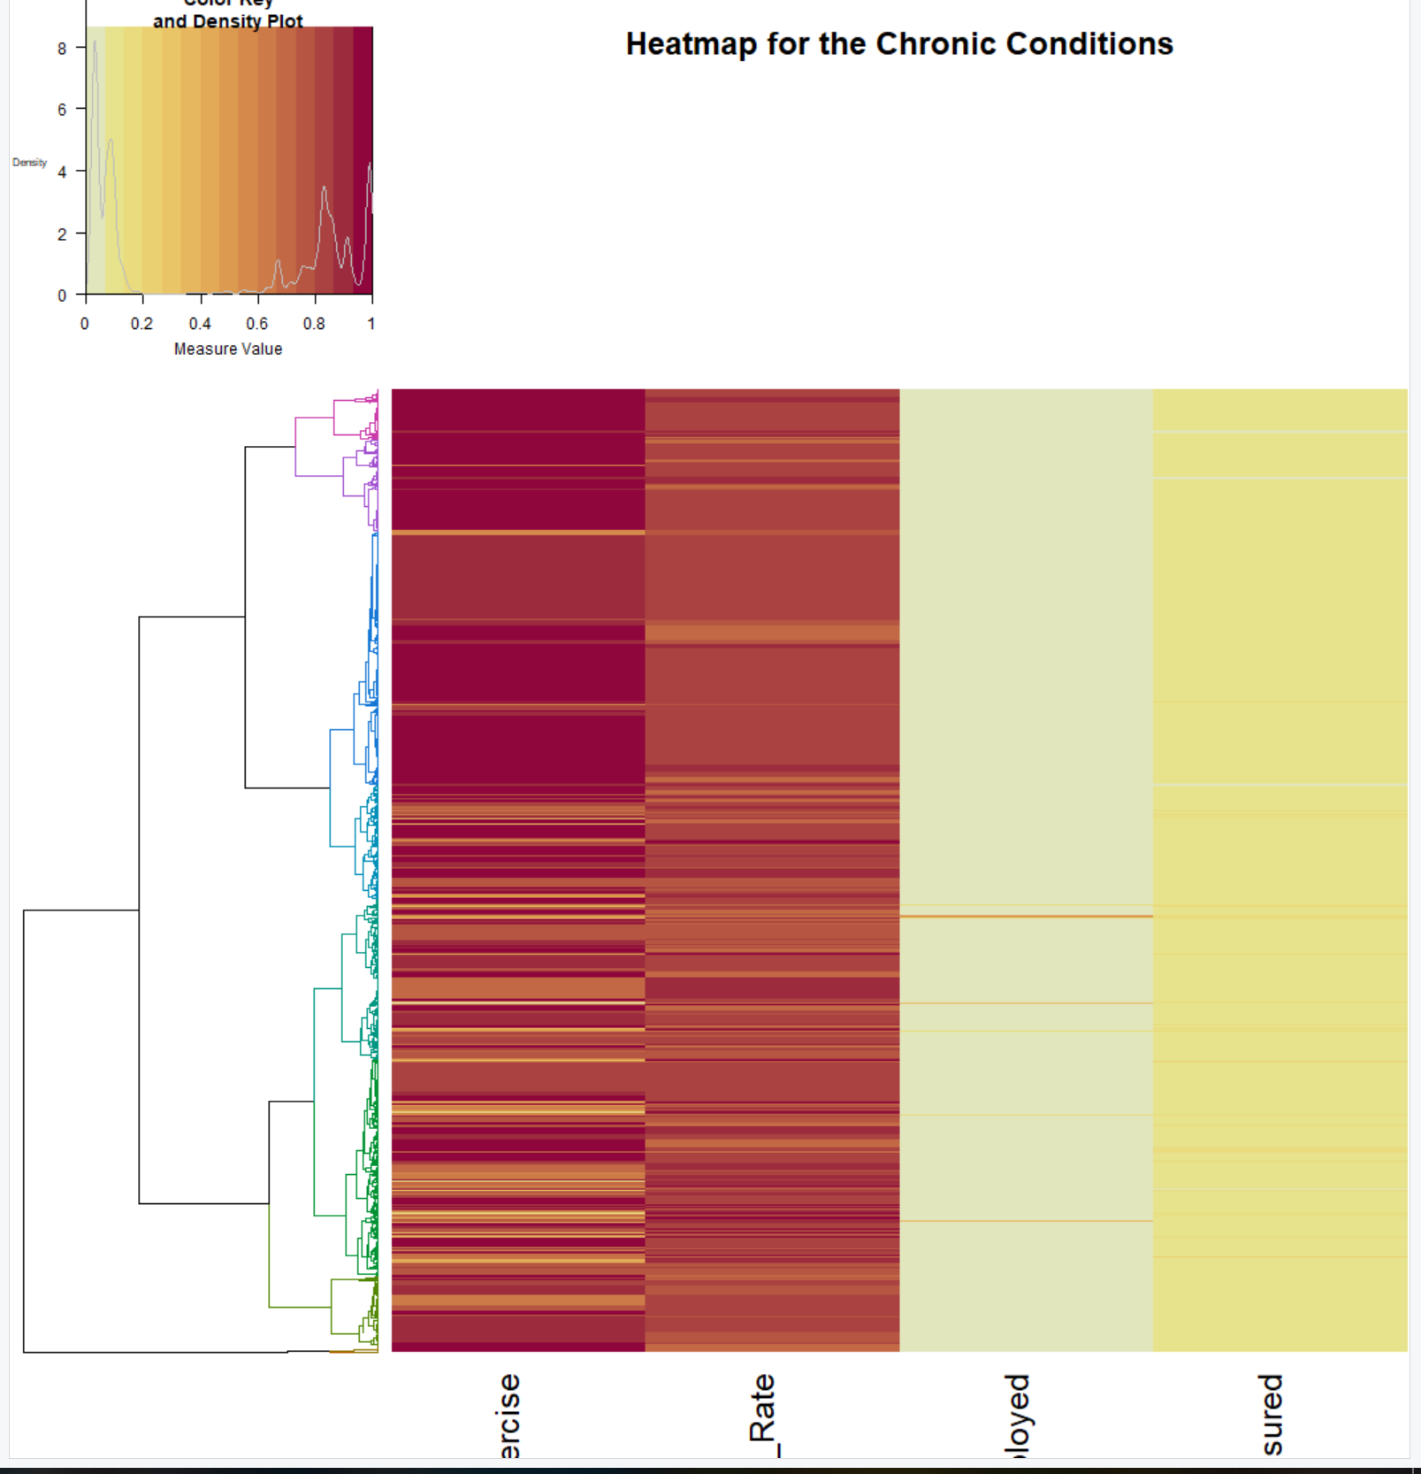
Hierarchical Cluster Analysis
Group 4: Access to Exercise, High School Grad Rate, % Unemployed, % Uninsured
Group 1: BP Systolic, BP Diastolic, Temperature, Pulse
Group 2: Respirations, BMI, BSA, Poverty Rate
Group 3: Population and Low Access to Supermarket

Slide 28
Hierarchical Cluster analysis
Within the heat maps I noticed the measures doing either 1 of 2 things
They were consistent throughout so every record was within the same range
The measure was wildly inconsistent and the same levels that were in one cluster were prevalent in another cluster
From looking at this, I believe it best to shift focus by testing the performance of the other methods of Hierarchical clustering
There 8 different methods so we have 7 to compare to.

Slide 29
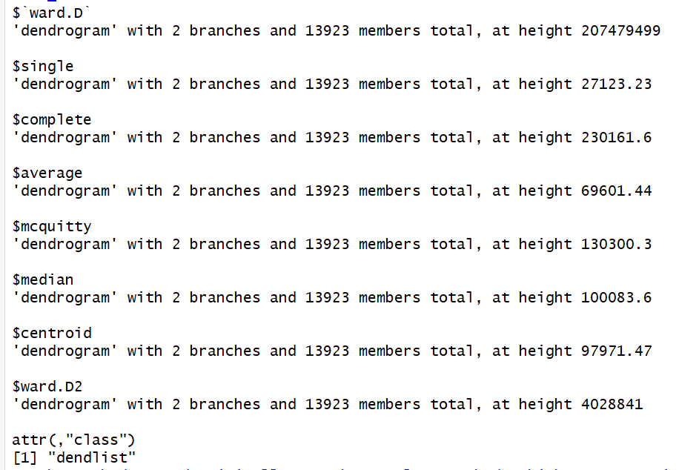
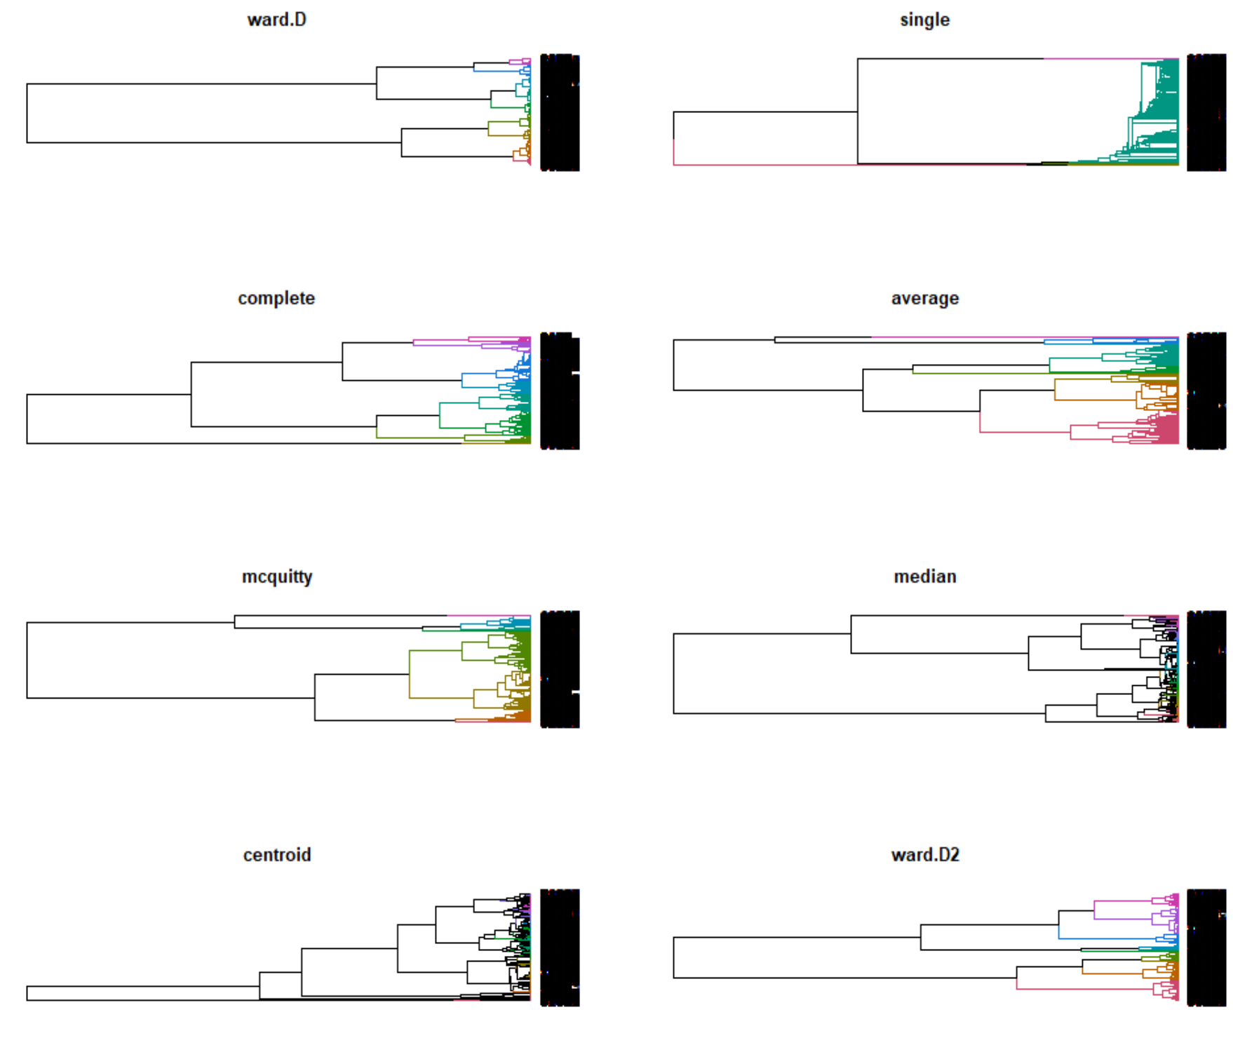
Hierarchical cluster analysis
To compare each of the methods we must run them against one another, then compare results.
When comparing it is clear we have some contrasting heights and appearances which is similar to what we have been seeing from our other visualizations within the HCA process.

Slide 30
Hierarchical Cluster Analysis
There were some slight similarities between different methods of the HCA.
The most accurate methods based on the group of dendrograms would be complete, average, mcquitty, and ward.D2.
Single, centroid and median appear to be the worst because the lack of color and iterations within their dendrograms.
It’s fair to conclude the goal of the patient encounter and social determinant variables having the ability to cluster the data into the correct chronic conditions is tough and inconclusive. Yes some of the methods appear to be have clustered the data accurately but there isn’t strong enough evidence to believe that definitively. And with the performance of each of the individual measures when put to heat maps their performance as well was poor and underwhelming not unveiling any possible patterns within the data based on the chronic conditions.

Slide 31
K-Means Analysis
The objective of K-means is to group similar data points together to discover possible patterns within the data.
K-Means will be used a bit differently than HCA was for this dataset.
For HCA, the goal was to take the measures within the dataset and cluster them based on chronic condition in hopes of uncovering a pattern between the chronic conditions and all the different measures.
For K-means were going to refine our investigation and look at clustering the data on 2-dimensional planes where each pairing will be examined to see if there is a possibility of clustering within the chronic conditions.

Slide 32
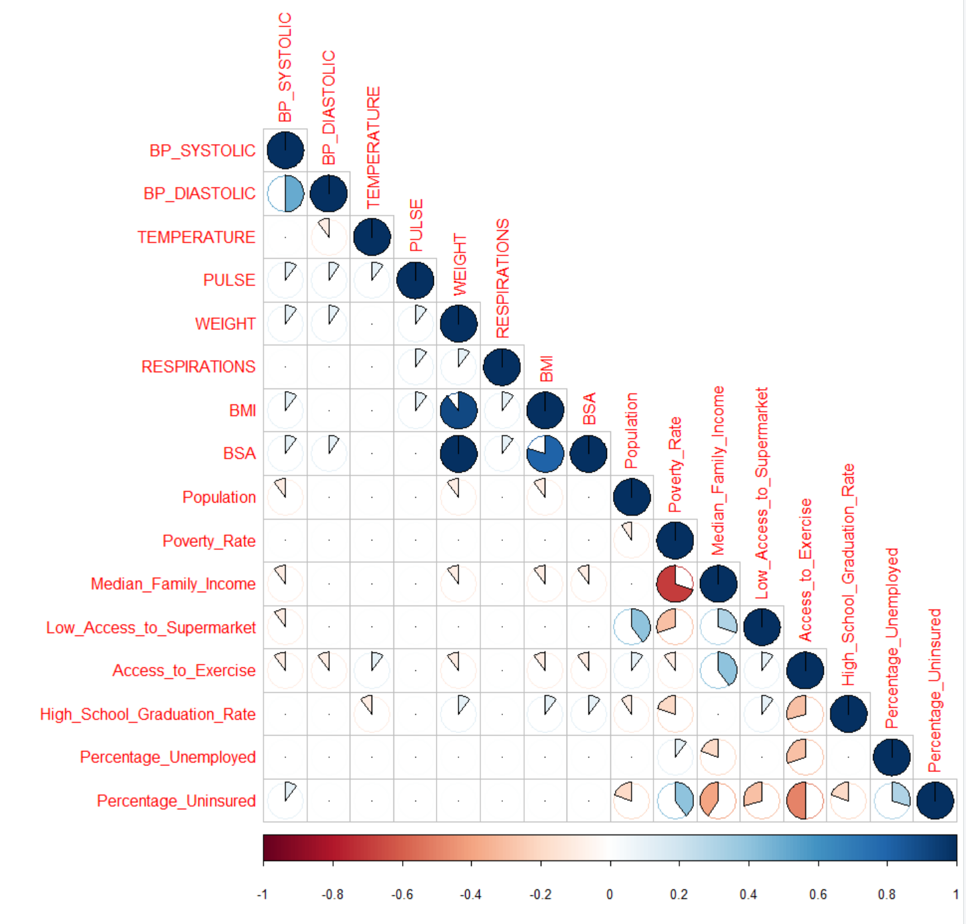
K-Means Analysis
Again, a correlogram is terrific for checking correlation strength amongst variables, here’s a look at another version of this type of chart.
Positive correlated pairs: BP Diastolic vs. BP Systolic, BMI vs. Weight, BSA vs. Weight, Supermarket access vs Population, Exercise Access vs. Median Family Income, % Uninsured vs. Poverty Rate, % Uninsured vs. % Unemployed
Negative correlated pairs: Median Family Income vs. Poverty Rate, HS Grad Rate vs Access to Exercise, % Unemployed vs. Access to Exercise, % Uninsured vs. Median Family Income, % Uninsured vs. Supermarket Access, % Uninsured vs. Access to Exercise
These correlated pairs will be what pairings to focus on when looking at our k-means clustering.

